Slide 1

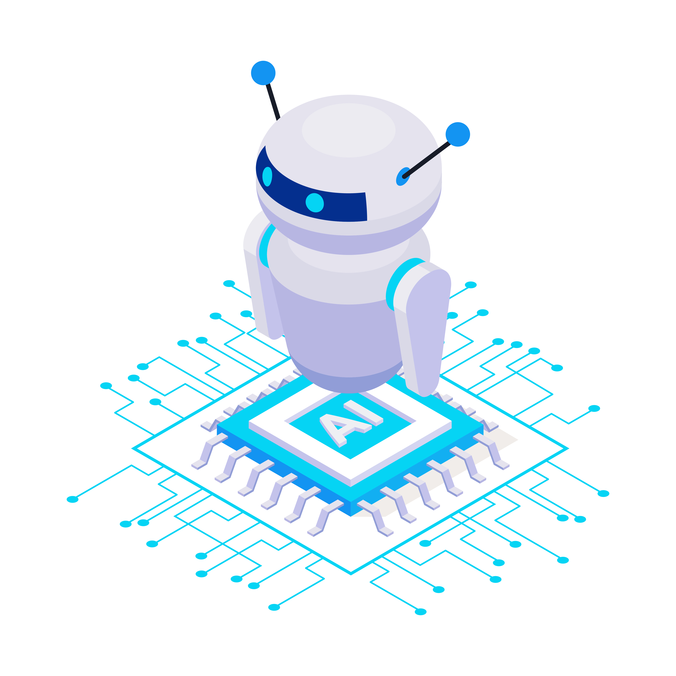



BUILD
Telegram ChatBot
with ChatGpt & Python Programming

Slide 2

Overview
Are you interested in building an AI-powered Telegram bot? Look no further! In this free
master class, we will explore how to build an intelligent Telegram bot using ChatGPT
and Python programming.
Chat GPT is a powerful language model that can understand natural language, generate
text, and respond to queries in a conversational manner. In this class, we will explore
how to integrate ChatGPT with Telegram API to create a bot that can answer questions,
provide recommendations, and engage in dynamic conversations.

Slide 3



Passionate about Data
Engineering, Big Data, and
Software Development
Languages: Scala, Python,
Golang, SQL, Hindi & English
Frameworks/Tools: Airflow,
Kafka, Hadoop, Spark, Sqoop,
Hive, HBase, AWS, Snowflake,
Linux, GIT
About Me?

Slide 4
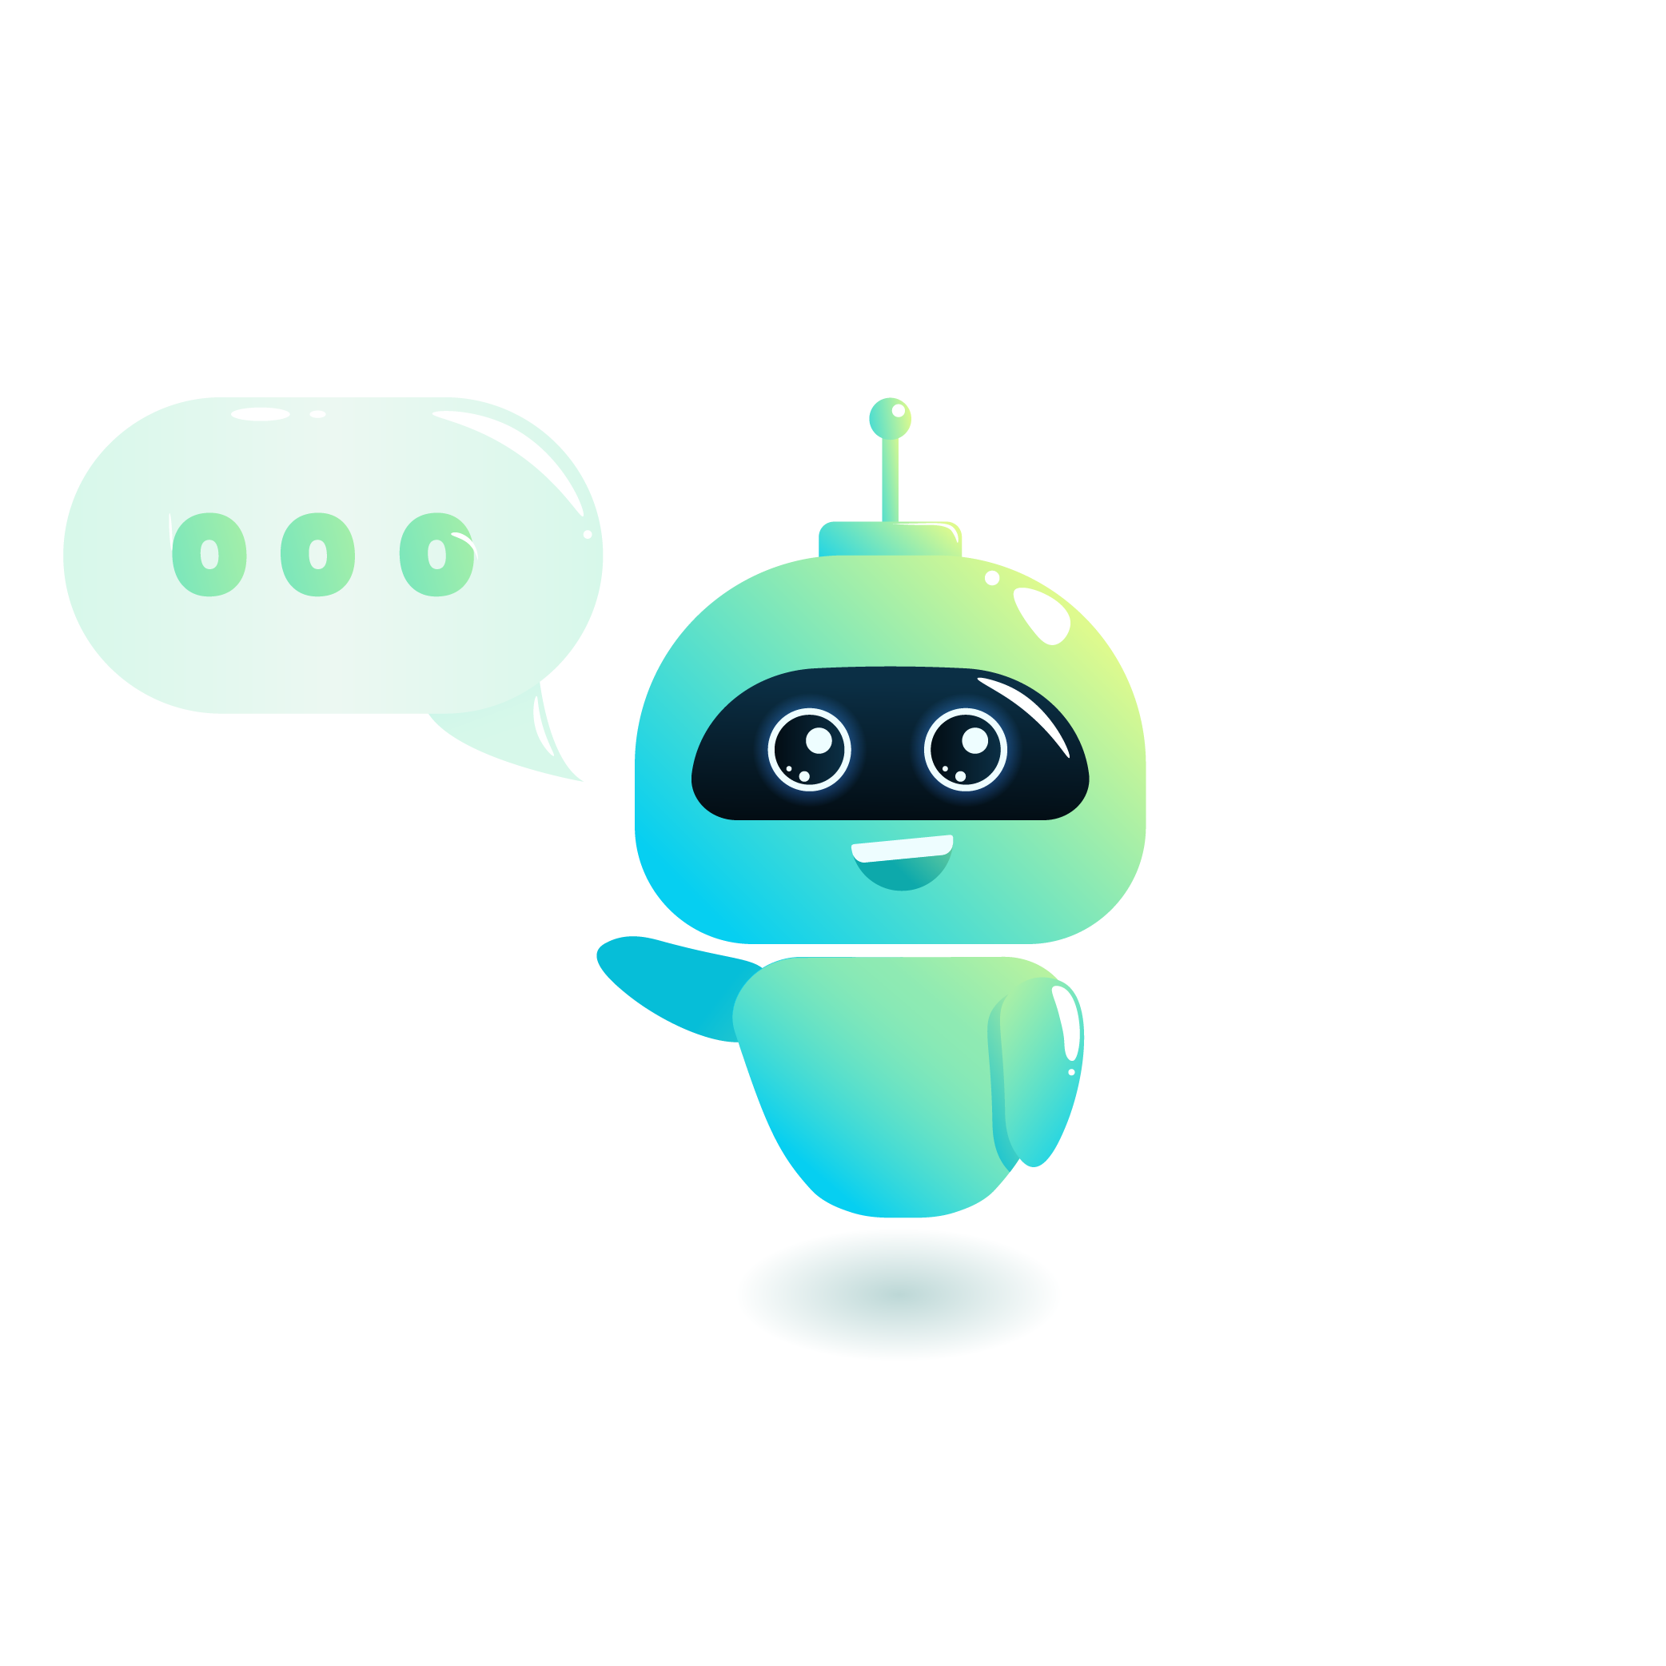
Python Programming
Telegram API
OpenAI API
Telegram Bot Father
Skills & expertise
(for this Project)

Slide 5


Project Timeline
Python Setup
Install, venv setup, library install
OpenAI
Account creation and api key
Introduction to Environment Variables
Setting up environment Variables
Telegram bot father
Create new bot and bot token

Slide 6
Thank you !

